Slide 1

By: Edwin Ho, Roldan Gammad, Peter Truong, and Efren Aguilar

Slide 2
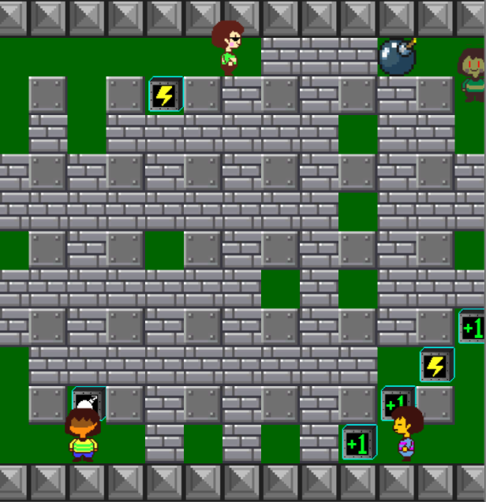
Core Gameplay
4 Players
Different controls on players.
Four power ups
Bomb Count
Explosion Size
Invulnerability
Speed up

